Slide 1
STORE SALES AND PROFIT ANALYSIS
Team Members
Ronit V Raghavan [1DB21CI075]
Yuvaraj B L [1DB21CI110]
Haneesh Kumar D [1DB21EC050]
Gowtham N [1DB21EC047]
Notes:
Note:

Slide 2
STORE SALES AND PROFIT ANALYSIS
UNIT 1. Problem Statement
Run Analysis on a Store’s Sale and Profits based on the given Data set and obtain the requirements
Click Here to Access the Problem statement
Notes:
Note:

Slide 3
STORE SALES AND PROFIT ANALYSIS
UNIT 2. Data Set Involved
Click here to access the Data set
Notes:
Note:

Slide 4
STORE SALES AND PROFIT ANALYSIS
UNIT 3. Data Analysis and Visualization Concepts Applied
1. Data Cleaning and Preparation:
-Data is read from 'Sample - Superstore.csv' using Pandas, unwanted columns are dropped, and 'Order Date' is converted to datetime, adding new columns for 'Order Day', 'Order Month', and 'Order Year’.
2. Monthly Data Analysis:
- Two line charts are created using plotly.express to visualize the monthly sales and profit trends over the years.
3. Category Data Analysis:
- A pie chart is created using plotly.express to visualize the distribution of sales across different categories.
4. Sub-Category Data Analysis:
- Two bar charts are created using plotly.express to visualize the sales and profit for each sub-category.
5. Customer Segment Data Analysis:
- A grouped bar chart is created using plotly.graph_objects to visualize the sales and profit for each customer segment.
Notes:
Note:

Slide 5
STORE SALES AND PROFIT ANALYSIS
UNIT 4. Outcomes
1. The store's monthly sales will be analyzed and presented visually using a Line Chart.
2. Sales analysis for the store's categories and sub-categories (products) will be conducted and visualized using Pie or/and Bar charts.
3. The monthly profit of the store will be analyzed and visually represented through a Line Chart.
4. Profit analysis for the store's categories and sub-categories (products) will be performed and presented visually using Pie or/and Bar charts.
5. Customer segments' sales and profit analysis will be visualized using a Bar chart.
Notes:
Note:

Slide 6
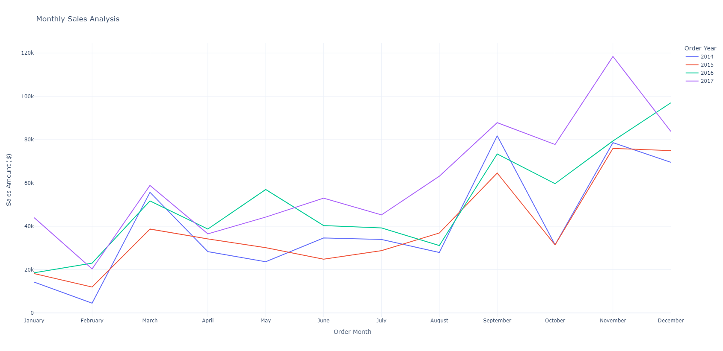
STORE SALES AND PROFIT ANALYSIS
Visualization
Monthly Sales Analysis
Notes:
Note:

Slide 7
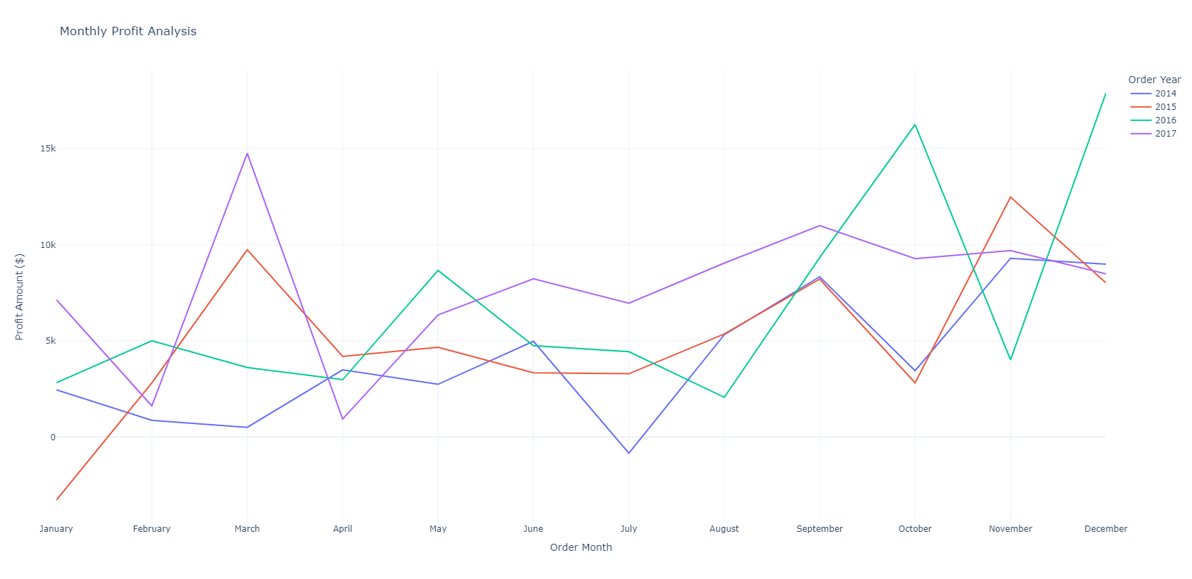
STORE SALES AND PROFIT ANALYSIS
Visualization
Monthly Profit Analysis
Notes:
Note:

Slide 8
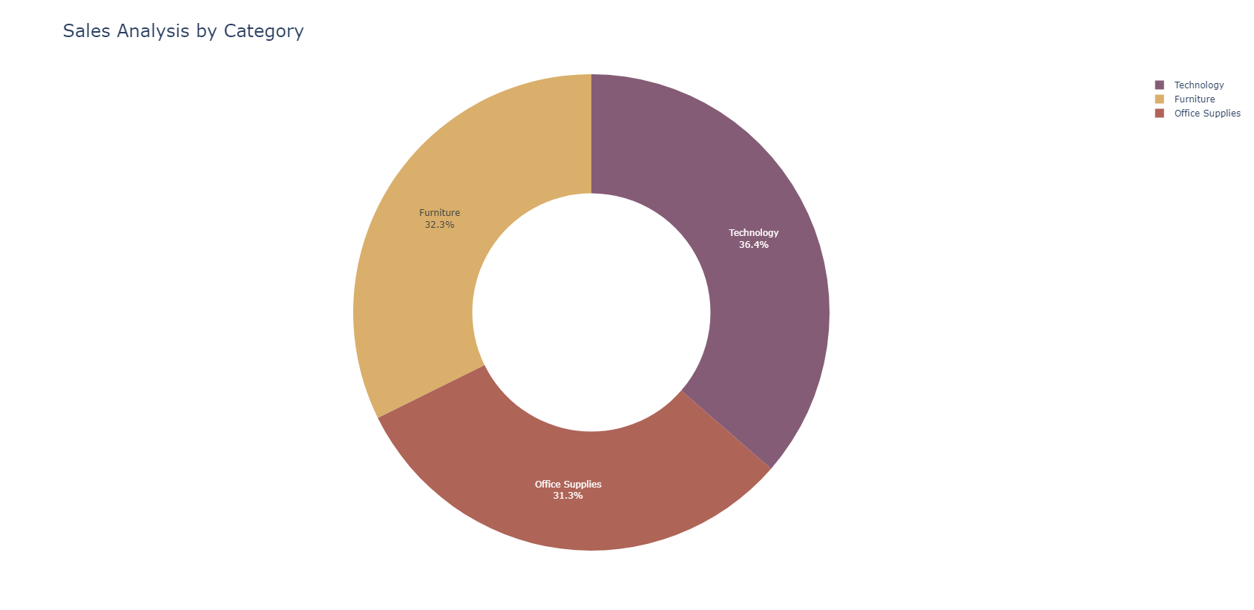
STORE SALES AND PROFIT ANALYSIS
Visualization
Category Sales Analysis
Notes:
Note:

Slide 9
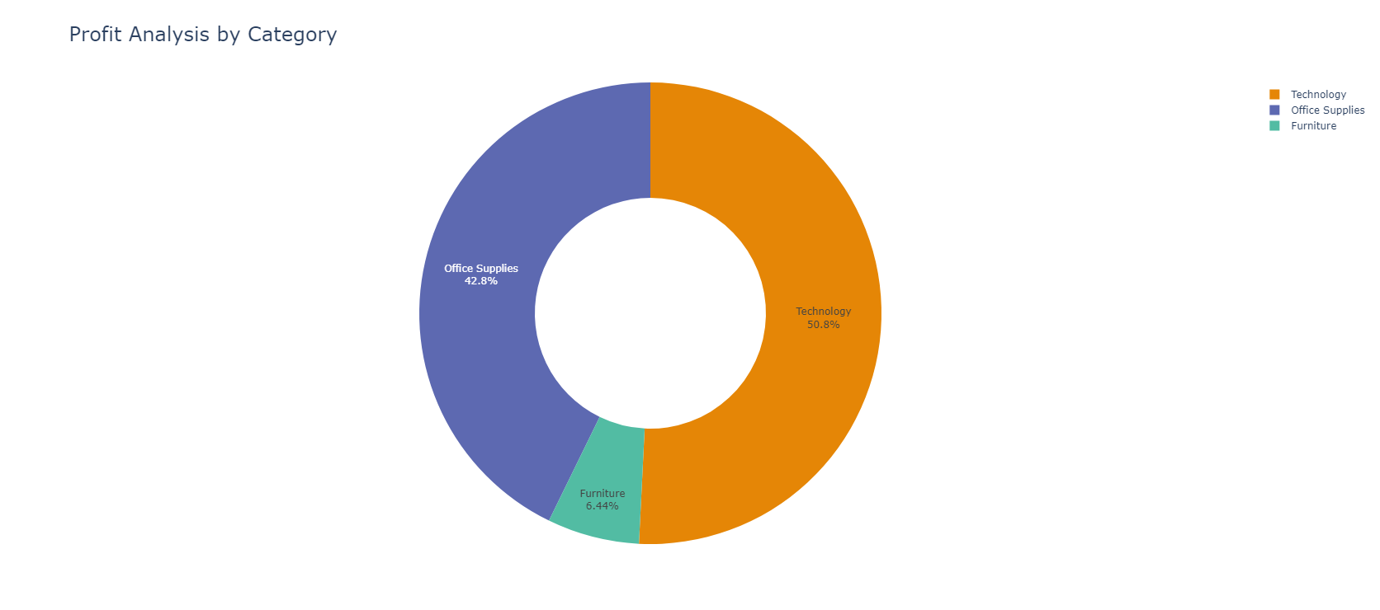
STORE SALES AND PROFIT ANALYSIS
Visualization
Category Profit Analysis
Notes:
Note:

Slide 10
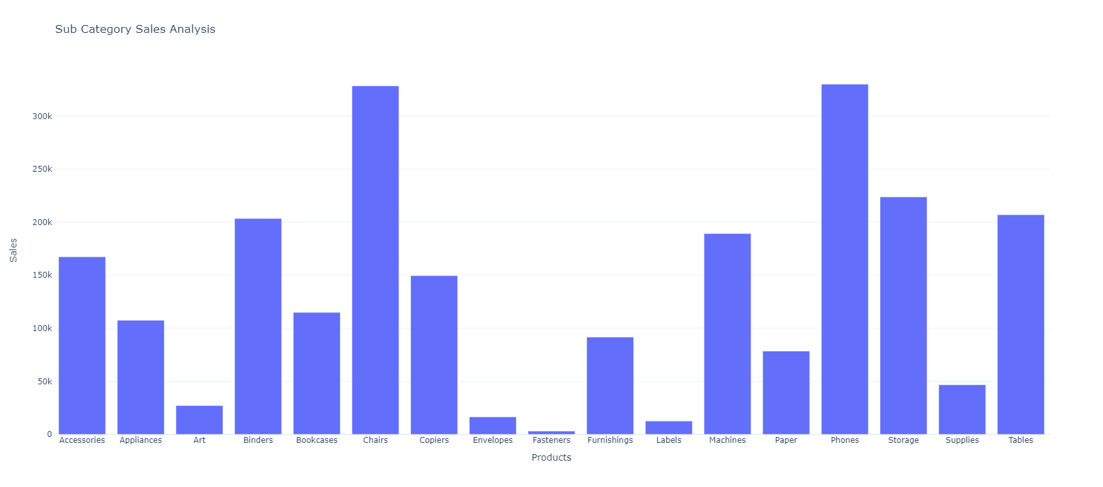
STORE SALES AND PROFIT ANALYSIS
Visualization
Sub Category Sales Analysis
Notes:
Note:

Slide 11
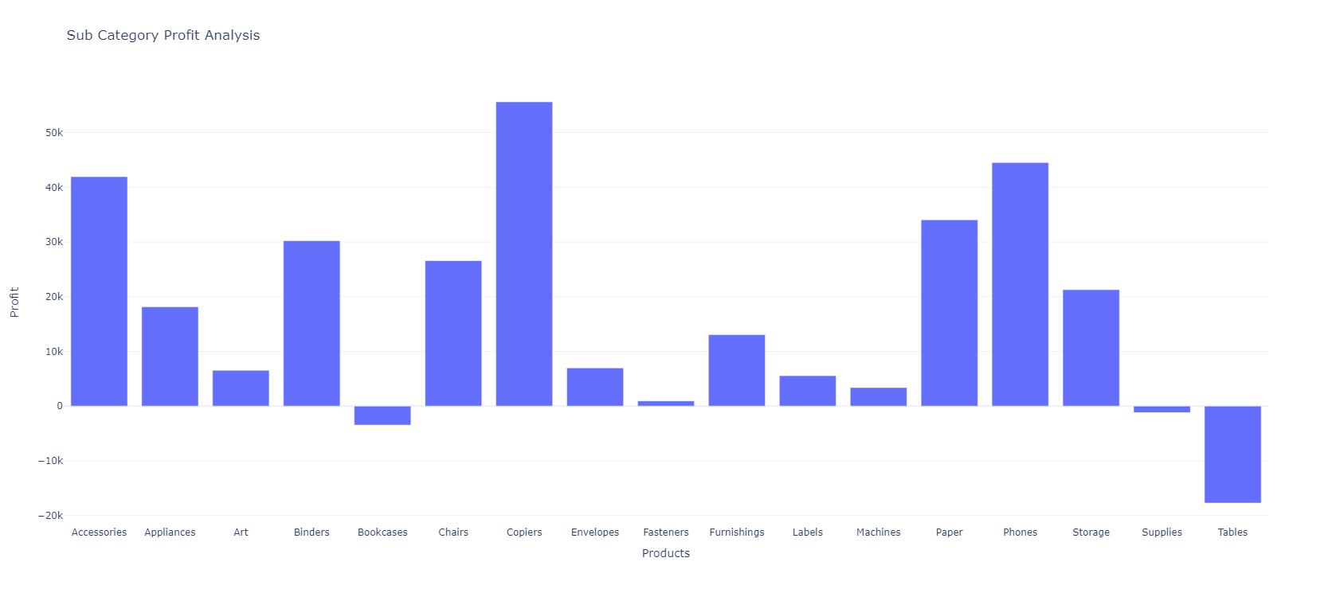
STORE SALES AND PROFIT ANALYSIS
Visualization
Sub Category Profit Analysis
Notes:
Note:

Slide 12
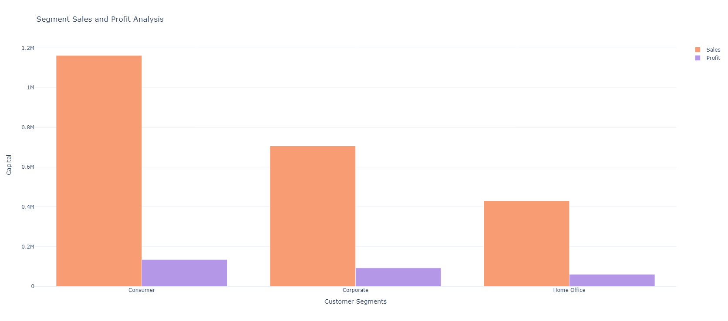
STORE SALES AND PROFIT ANALYSIS
Visualization
Segment Category Sales and Profit Analysis
Notes:
Note:

Slide 13
STORE SALES AND PROFIT ANALYSIS
Conclusion
In conclusion, the code presented a robust data analysis and visualization approach for understanding store sales and profit dynamics. By leveraging Python's powerful data manipulation and visualization libraries, the code successfully provided valuable insights for making informed business decisions. The visualizations offered a clear and concise representation of key performance indicators, enabling stakeholders to identify areas of strength and opportunities for improvement within the business operations.
Notes:
Note:

Slide 14
STORE SALES AND PROFIT ANALYSIS
Conclusion
Here is the breakdown of project contributions for the tasks:
Yuvaraj: Created new columns for order month, order year, and order day.
Ronit: Performed Monthly Sales Analysis and displayed it as a line chart.
Haneesh: Conducted sales by category Analysis and displayed it as a pie chart.
4. Gowtham: Analyzed sales by sub-category and displayed it as a bar chart.
5. Yuvaraj: Performed Monthly Profit Analysis and displayed it as a line chart.
6. Ronit: Conducted profit by category Analysis and displayed it as a pie chart.
7. Haneesh: Analyzed profit by sub-category and displayed it as a bar chart.
Gowtham: Conducted sales and profit analysis by customer segments and displayed it as a
bar chart.
Notes:
Note:

